Slide 1
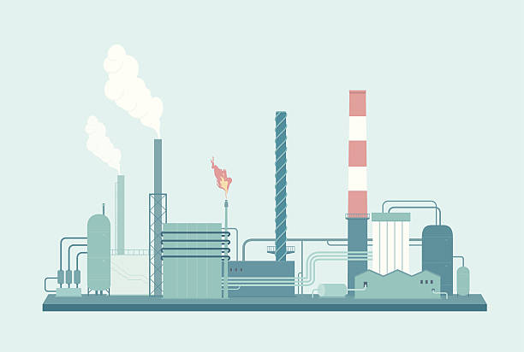
Power Production and Atmospheric Conditions
By: Mason Baird, Weston King-Leatham,
Sinclair Fuh, Matt Manoly, and Mikael Yemane

Slide 2
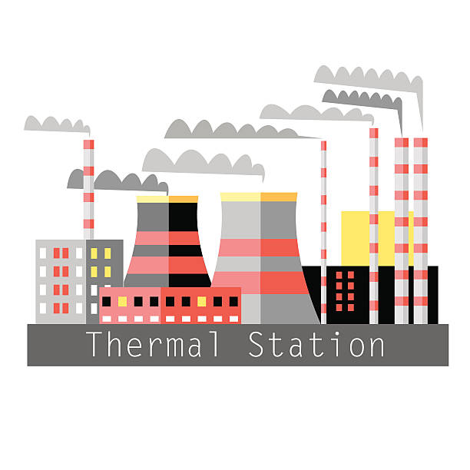
Proposed Question
What effects do different types of power plants have on air quality in their surrounding areas?

Slide 3
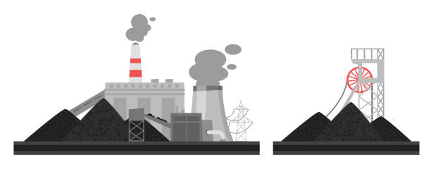
Motivation
World Health Organization estimates that every year, 2.4 million people die because of the effects of air pollution on health.
92 percent of the global population lives in places with unhealthy air quality
NASA study estimated that between 1976 and 2009, humans use of nuclear energy has saved 1.8 million lives through cleaner, less polluted air
The type of power plant we use can affect our health

Slide 4
About PM 2.5
What is it?
Particulate Matter 2.5 refers to tiny particles or droplets in the air that are two and one half microns or less in width.
How does it affect my health?
PM 2.5 can be inhaled deep into the lungs where gas exchange occurs with the bloodstream. When the small particles go deeply into the lungs and become trapped this can result in lung disease
Notes:
https://www.health.ny.gov/environmental/indoors/air/pmq_a.htm

Slide 5


About CO2
Most significant and long lived greenhouse gas
Greenhouse Effect → Climate Change
Acid Rain from dissolving into carbonic acid
Notes:
https://sciencing.com/list-5921485-effects-carbon-dioxide-air-pollution.html

Slide 6
Methodology
Grouped power plants by country
Percent of each plant type in use
Country’s cumulative power generation
Used PM2.5 and CO2 data from 2005 to 2014
Power plants commissioned past 2014 were not included
Tested on entire data set, and countries with 100 or more power plants

Slide 7
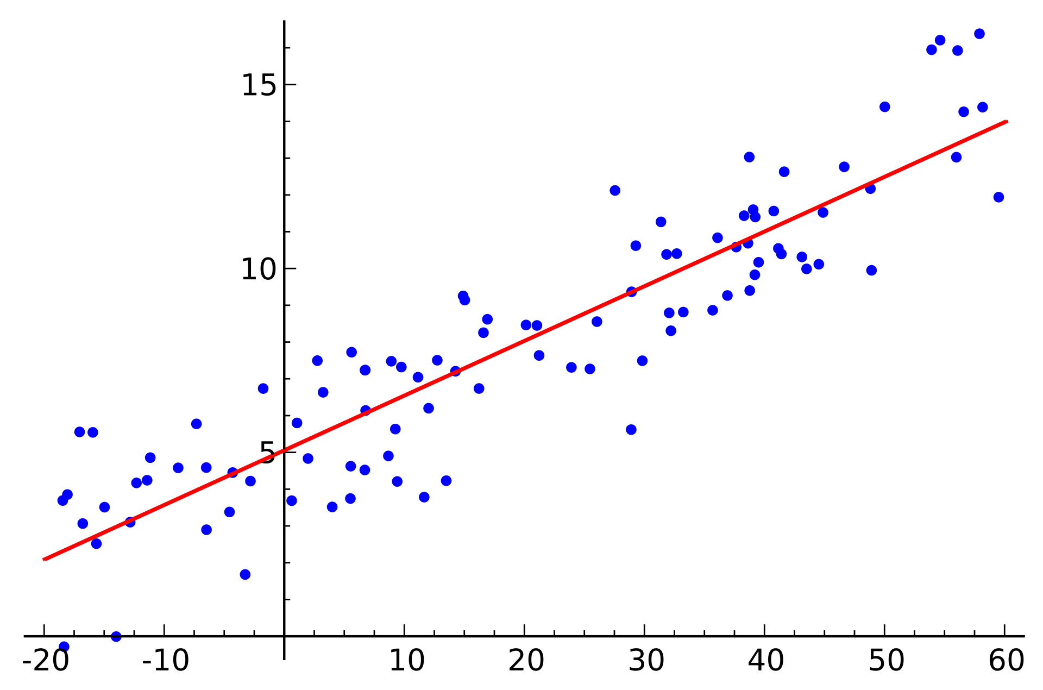
Methodology
Ordinary least squares regression model
Tested plant types against PM2.5 emissions by country
CO2 emission used as control variable

Slide 8
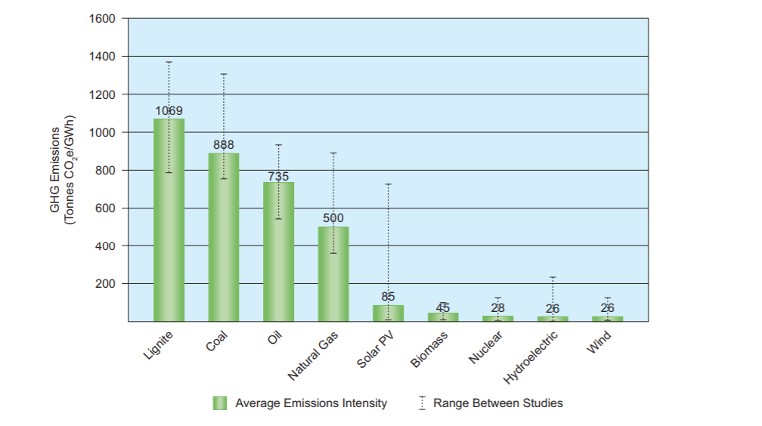
Previous Research - CO2
Notes:
WNA, Lifecycle Greenhouse Gas Emissions of Various Electricity Generation Sources

Slide 9
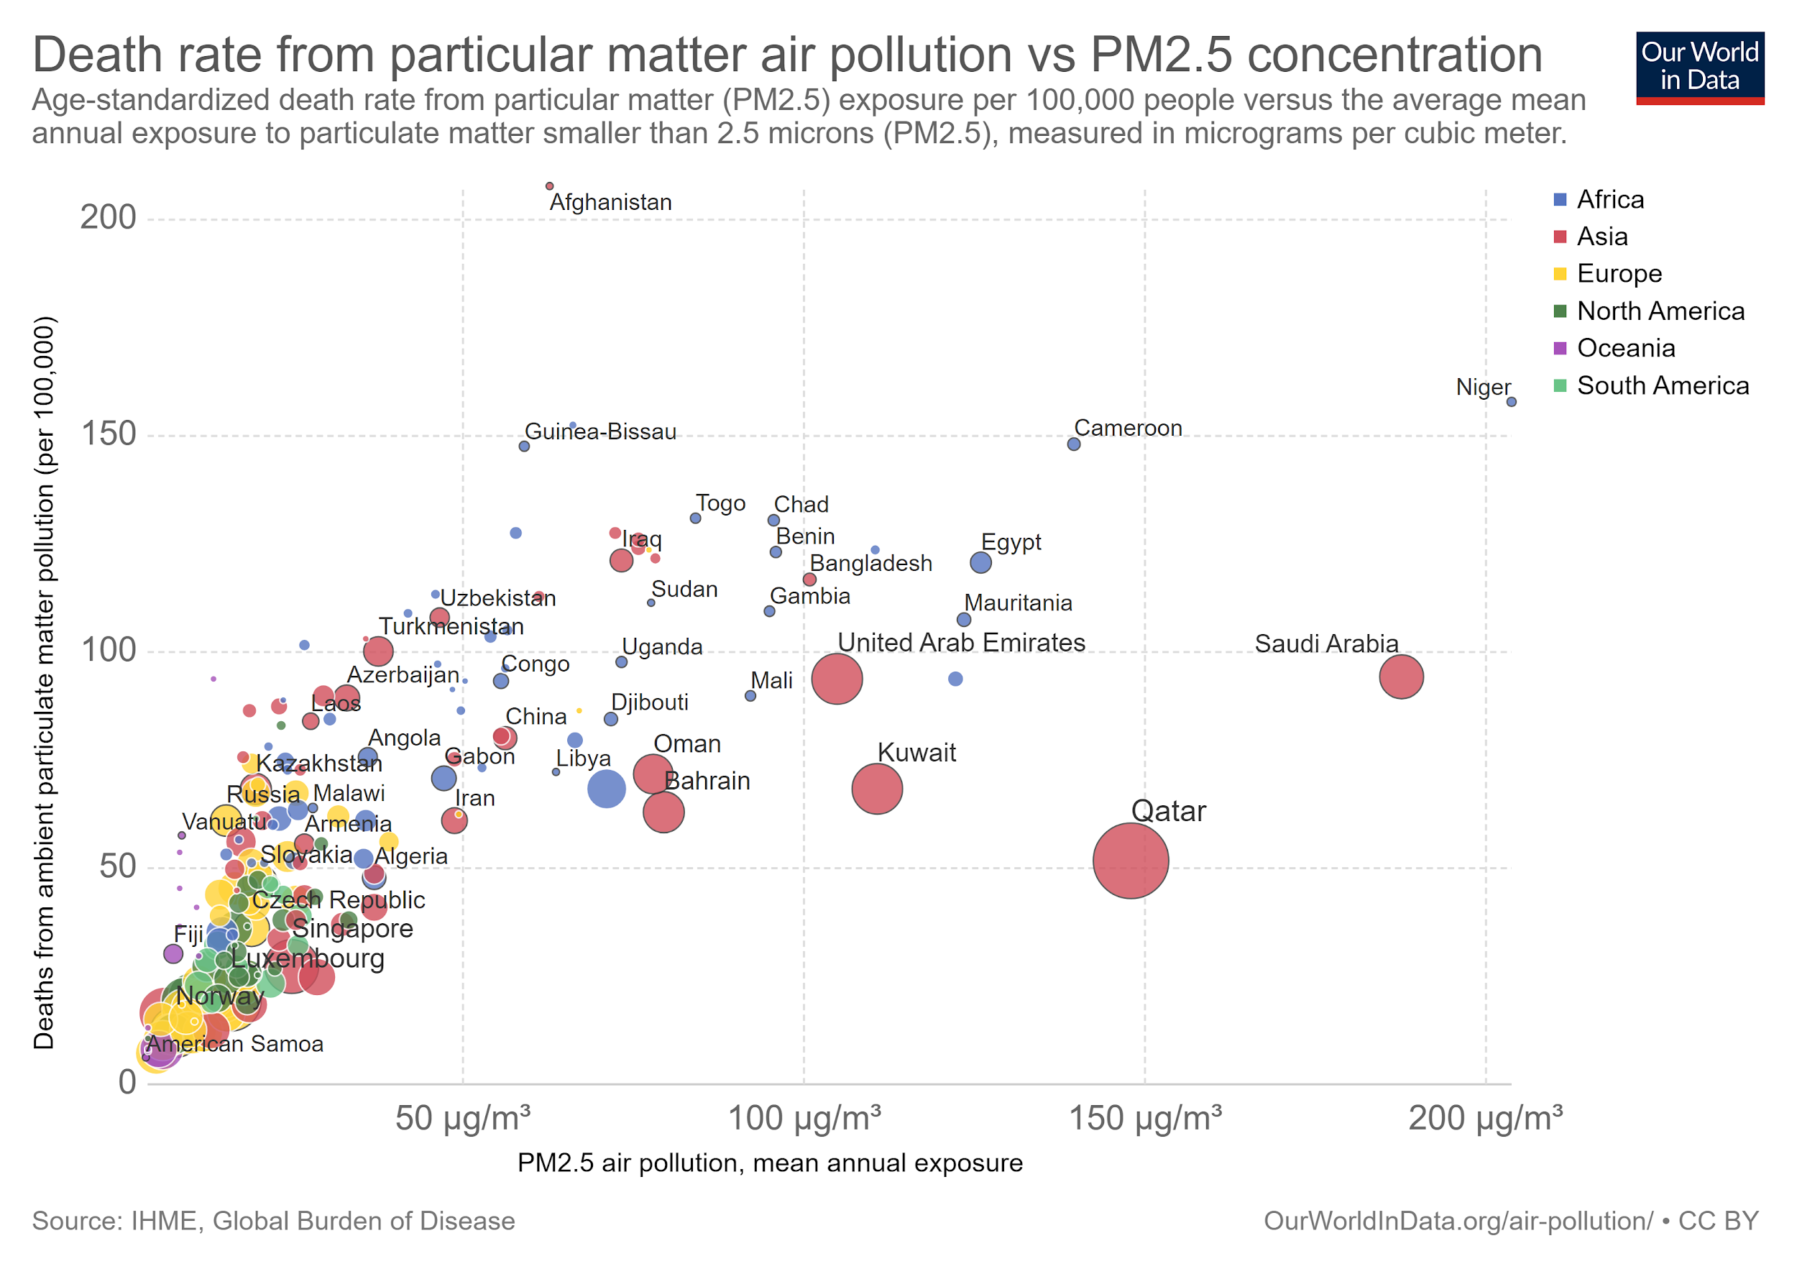
Prior Research - PM2.5
Notes:
Analysis on historical and current PM2.5 levels and how they affect death rate

Slide 10
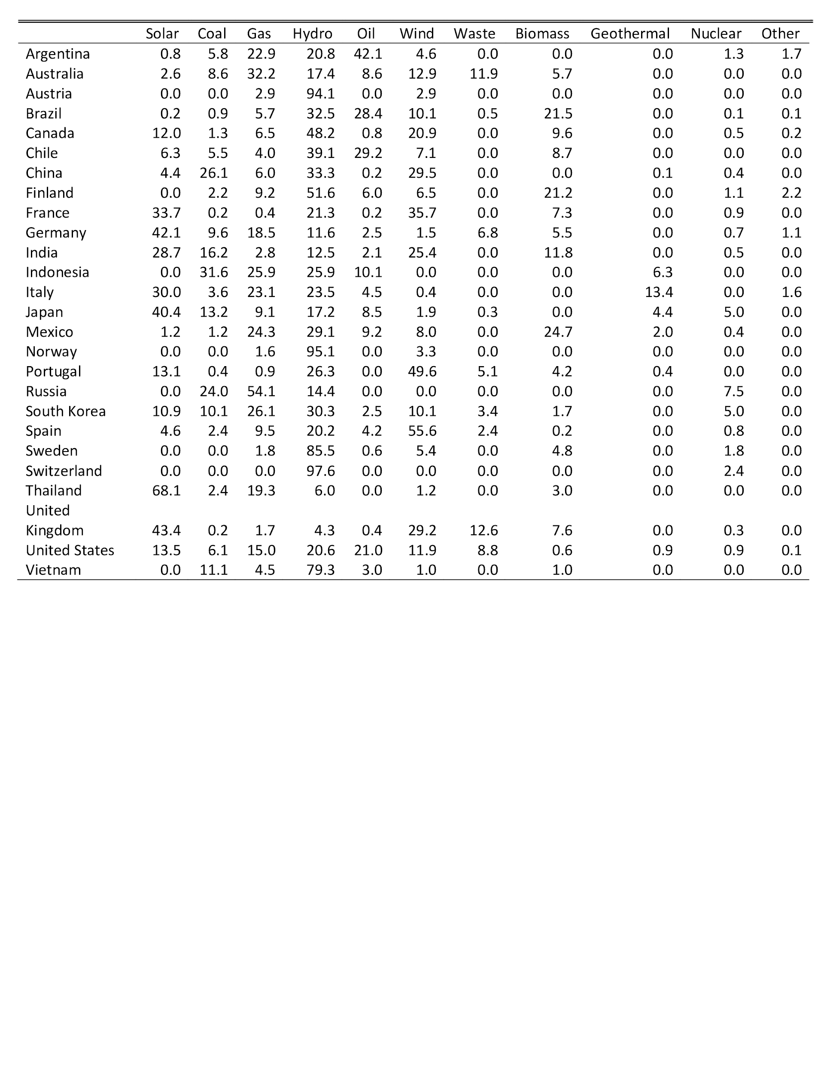
Descriptive Statistics

Slide 11
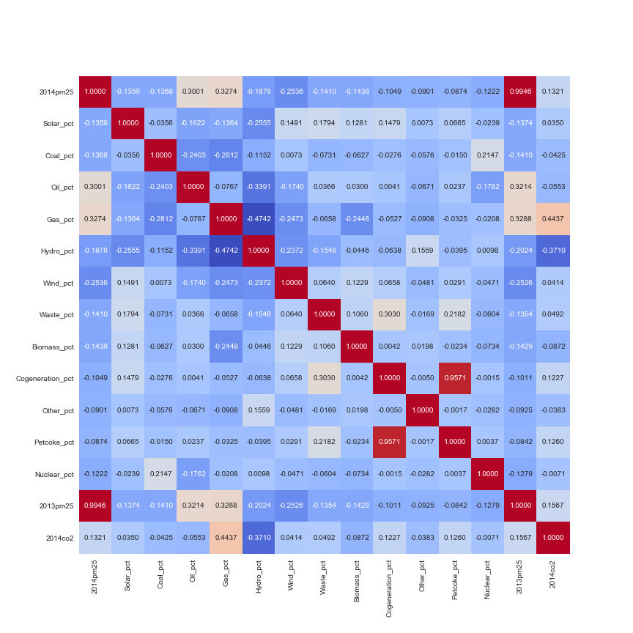
Correlation Matrix

Slide 12
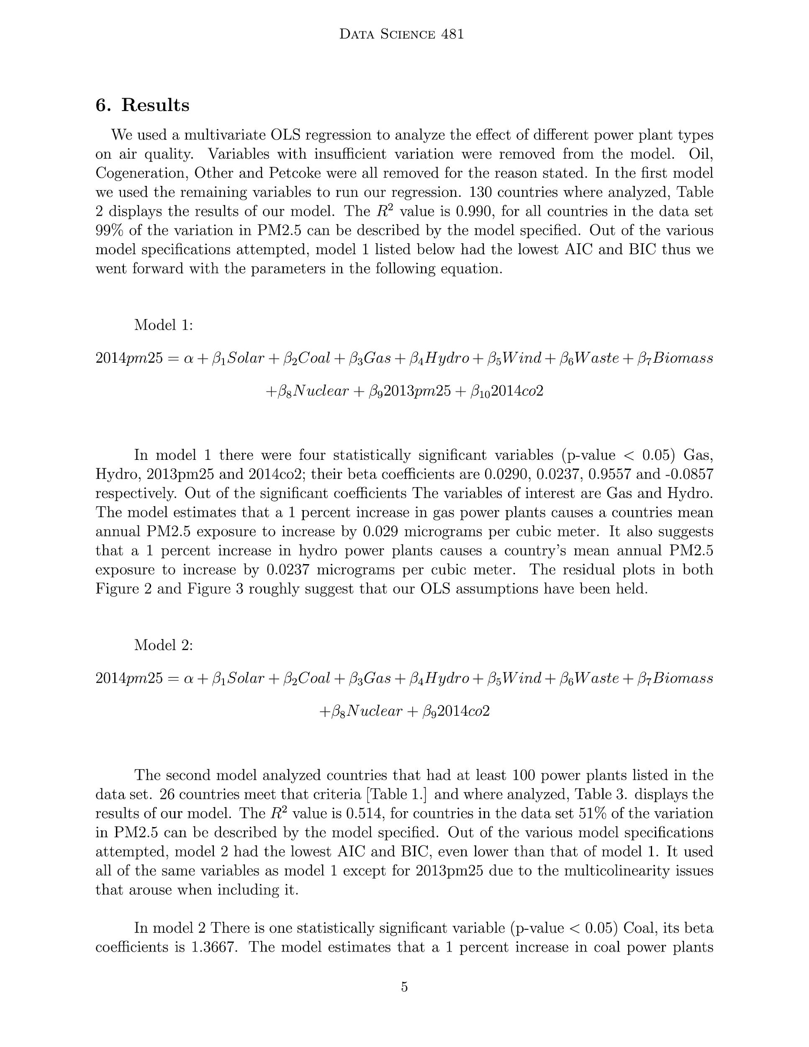
Model Specifications and Results
Model Specifications and Results
Model Specifications and Results
- 1% increase in gas power plants → country’s mean annual PM2.5 exposure to increase by 0.029 micrograms per cubic meter.
- 1% increase in hydro power plants → country's mean annual PM2.5 exposure to increase by 0.0237 micrograms per cubic meter
fications and Results
- 1% increase in coal power plants → country’s mean annual PM2.5 exposure to increase by 1.3667 micrograms per cubic meter.
fications and Results
Model Specifications and Results

Slide 13
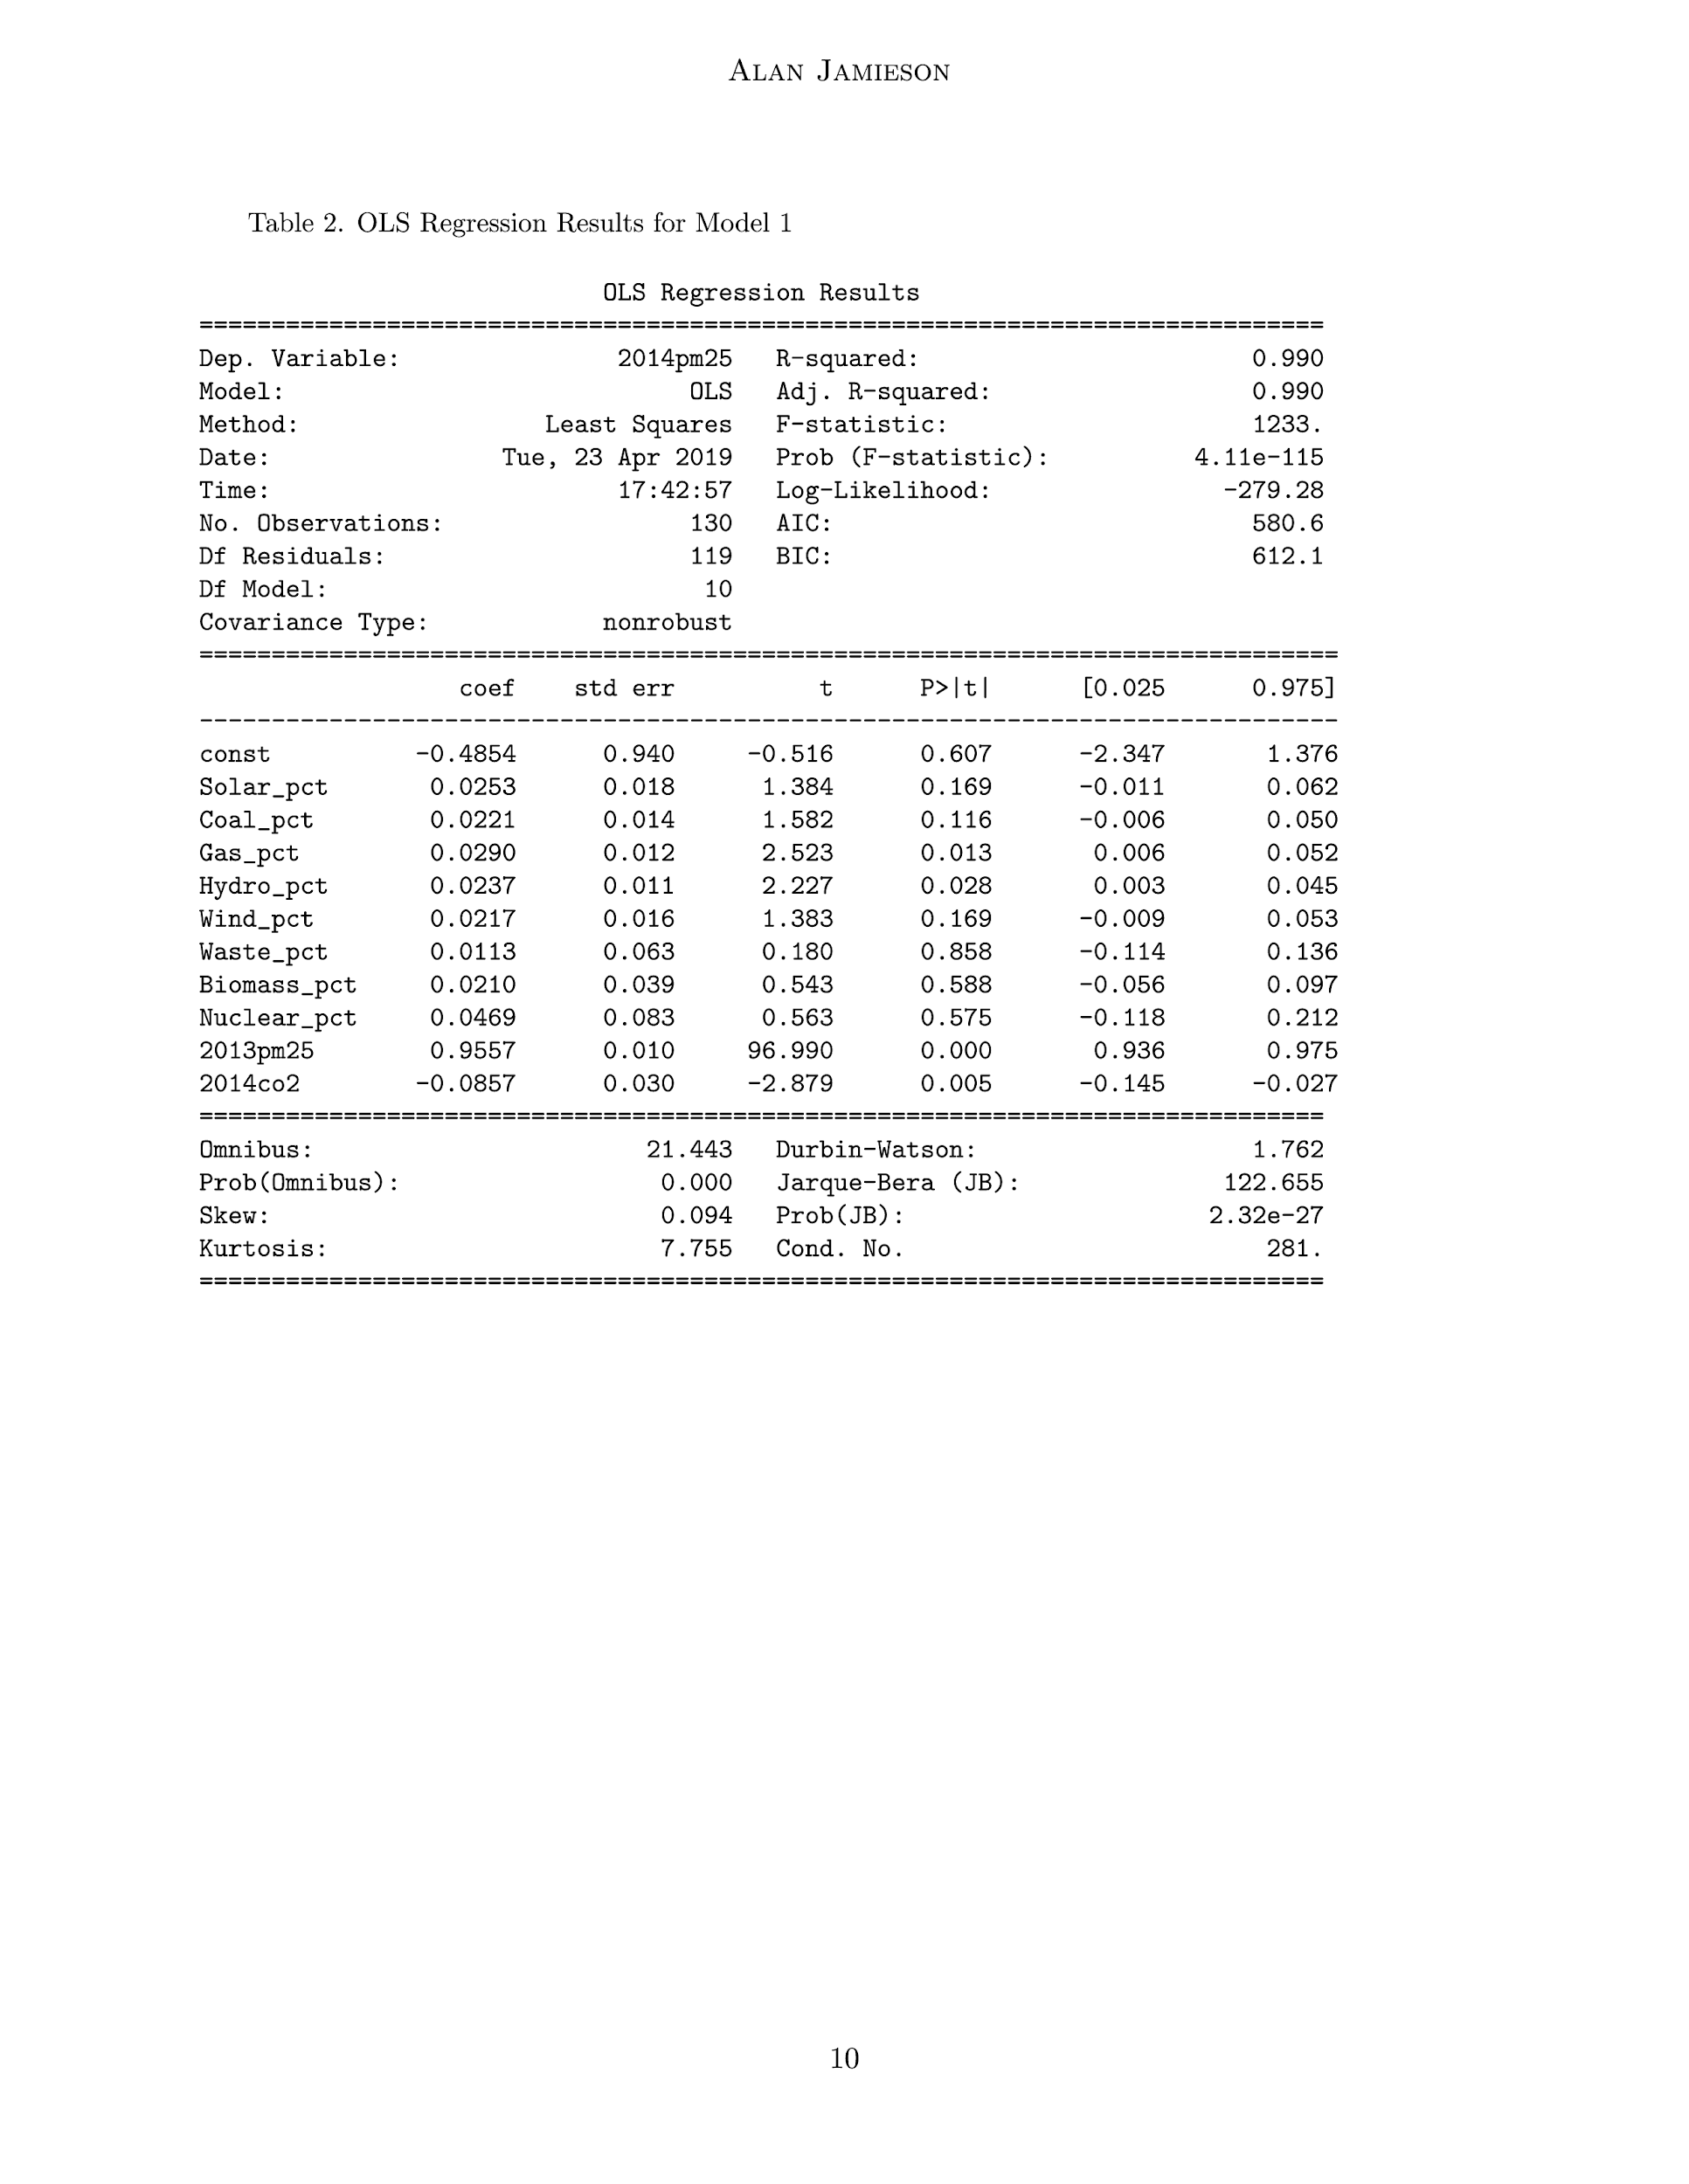
Results of Model 1

Slide 14
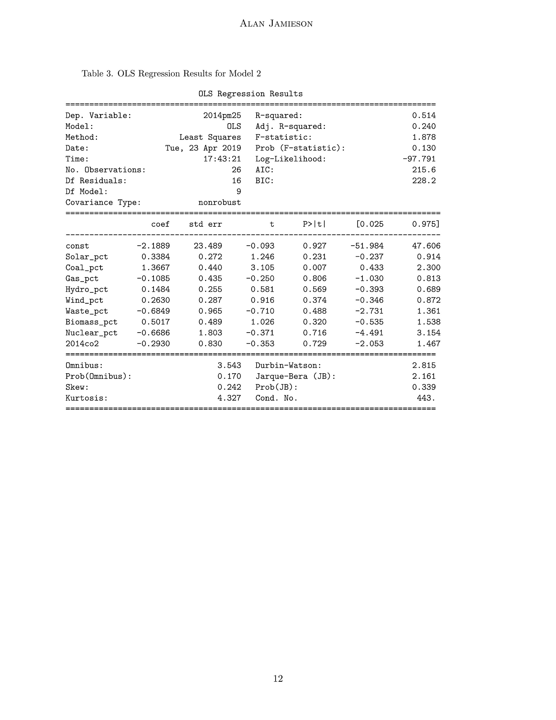
Results of Model 2

Slide 15
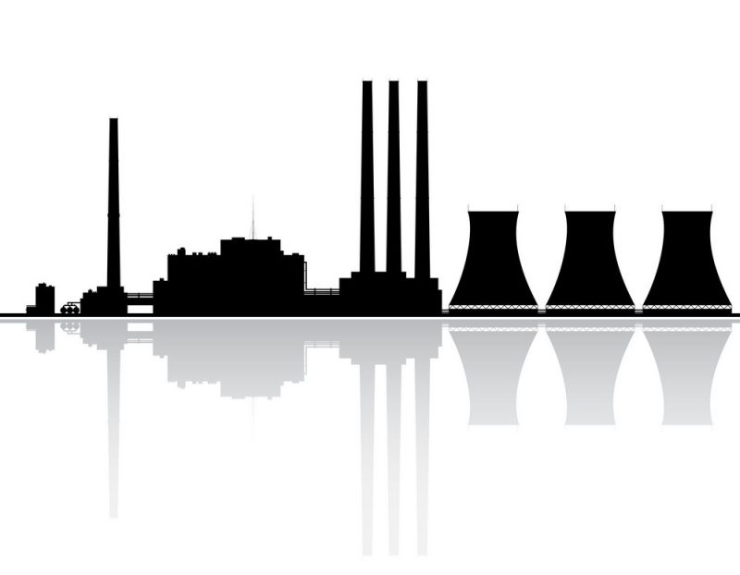
Conclusion [1]
Coal plants have disproportionately high particle emissions in comparison to every other plant in our dataset
High concentrations of coal power plants in southeast Asia
Particle emissions from China responsible for 1.6 million deaths annually
More research must be done to determine the atmospheric effects of other power plant types (nuclear, solar, waste, wind, etc...)
Notes:
https://www.ncbi.nlm.nih.gov/pmc/articles/PMC3532603/# ----- Sierra-Vargas, Martha Patricia, and Luis M Teran. “Air pollution: impact and prevention.” Respirology (Carlton, Vic.) vol. 17,7 (2012): 1031-8. doi:10.1111/j.1440-1843.2012.02213.x

Slide 16
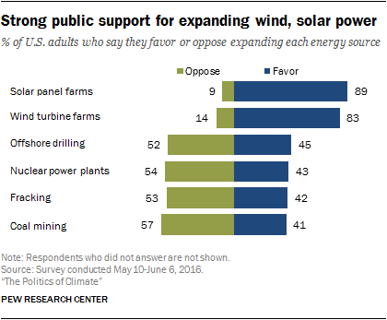

Slide 17
Conclusion [2]
Solar power not environmentally friendly in terms of particle emissions
Nuclear/Waste power plants best in terms of particle emissions
Public opinion favors solar power heavily over nuclear power
Notes:
https://www.ncbi.nlm.nih.gov/pmc/articles/PMC3532603/# ----- Sierra-Vargas, Martha Patricia, and Luis M Teran. “Air pollution: impact and prevention.” Respirology (Carlton, Vic.) vol. 17,7 (2012): 1031-8. doi:10.1111/j.1440-1843.2012.02213.x

Slide 18

The Future - Next Steps
Examine your electricity sources- avoid coal and gas
Try to reduce electricity usage
Ask your local representative about clean air initiatives
Use clean power sources- Wind, Solar, Nuclear

Slide 19
Data Sets Used
Power Plants Data:
http://datasets.wri.org/dataset/globalpowerplantdatabase
World CO2 levels:
https://data.worldbank.org/indicator/EN.ATM.CO2E.PC
World PM2.5 levels:
https://data.worldbank.org/indicator/en.atm.pm25.mc.m3
Notes:
Were all split by country, 2005-2014, Each power plant is geolocated with data entries containing information on plant capacity, power generation, ownership, and the fuel type. As of June 2018 the database includes statistics from around 28,500 power plants across 164 countries.

Slide 20
Citations
(1)“What Is Particulate Matter.” Understanding Particulate Matter, Air Quality, Particle Pollution, Dylos Corporation, www.dylosproducts.com/whispama.html.
(2) Ritchie, Hannah, and Max Roser. “Air Pollution.” Our World in Data, 17 Apr. 2017, ourworldindata.org/air-pollution.
(3)McIntyre, Jamie, et al. “Life Cycle Greenhouse Gas Emissions from Electricity Generation.” 2013, doi:10.2172/1338444.
(4) "Prevented Mortality and Greenhouse Gas Emissions from Historical and Projected Nuclear Power", https://pubs.acs.org/doi/abs/10.1021/es3051197?source=cen
(5) “Global Power Plant Database - Data | World Resources Institute.” Data, World Resources Institute, datasets.wri.org/dataset/globalpowerplantdatabase.
(6) “CO2 Emissions (Metric Tons per Capita).” Data, World Bank, \newline data.worldbank.org/indicator/en.atm.co2e.pc.
(7) “PM2.5 Air Pollution, Mean Annual Exposure (Micrograms per Cubic Meter).” Data, World Bank, data.worldbank.org/indicator/en.atm.pm25.mc.m3.

Slide 21
Citations
(8) “WHO releases country estimates on air pollution exposure and health impact” 2016 https://www.who.int/en/news-room/detail/27-09-2016-who-releases-country-estimates-on-air-pollution-exposure-and-health-impact
(9) National Geographic Society. “Air Pollution.” National Geographic Society, National Geographic, 9 Oct. 2012, www.nationalgeographic.org/encyclopedia/air-pollution/.
(10) "Air Pollution in China: Mapping of Concentrations and Sources", Robert A. Rohde, Richard A. Muller, http://berkeleyearth.org/wp-content/uploads/2015/08/China-Air-Quality-Paper-July-2015.pdf
(11) Pew Research Center, "Public opinion on renewables and other energy sources" Pew Research Center, October 4, 2016, https://www.pewresearch.org/science/2016/10/04/public-opinion-on-renewables-and-other-energy-sources/.
(12) "Fatalities chargeable to the Mining Industry" 2019
https://arlweb.msha.gov/stats/charts/combined.php

